Slide 1

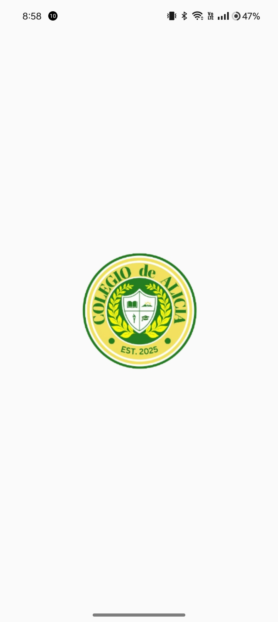
Teacher App
COLLEGIO DE ALICIA

Slide 2

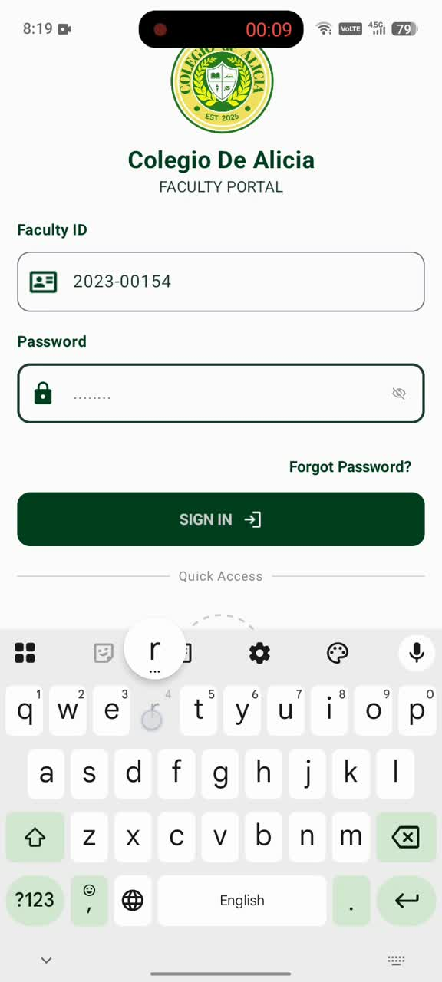
LOG IN
ACCOUNT

Slide 3

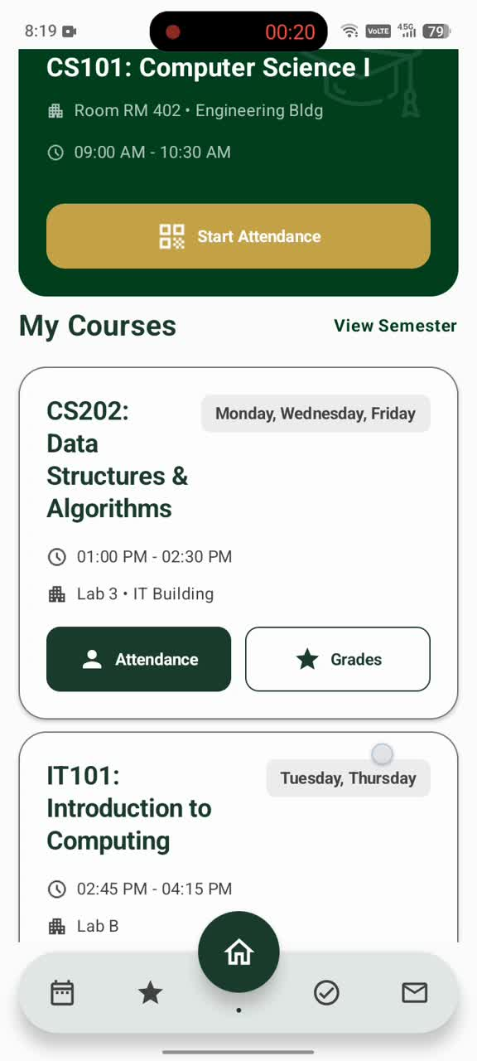
DASH
BOARD

Slide 4
WHAT’S MORE?

Slide 5

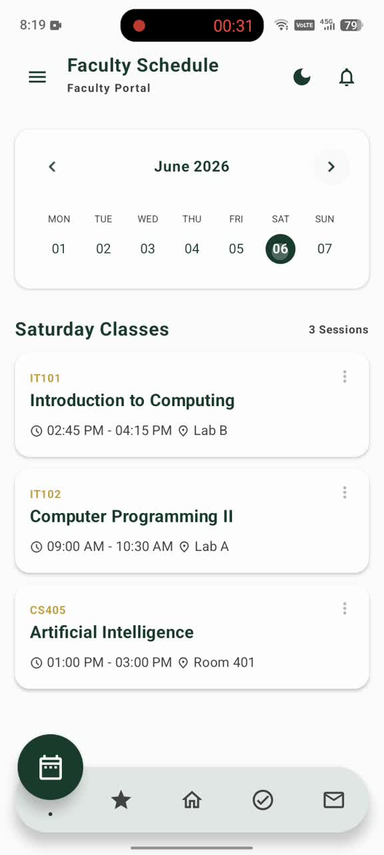
Faculty
Schedule

Slide 6
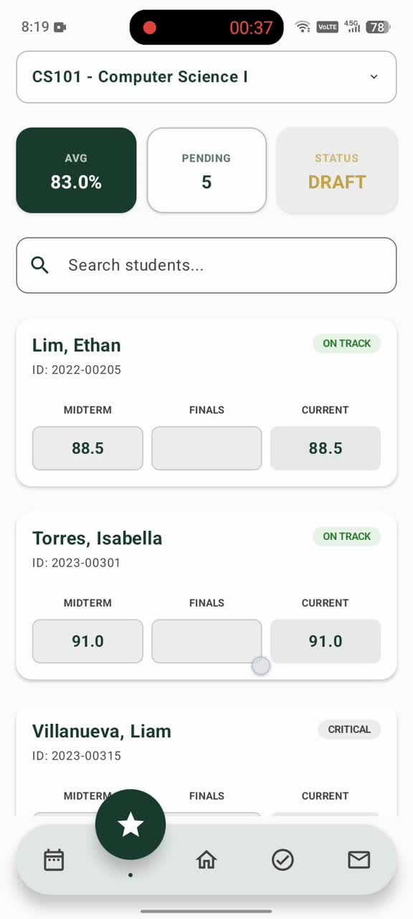
Grade
Management

Slide 7
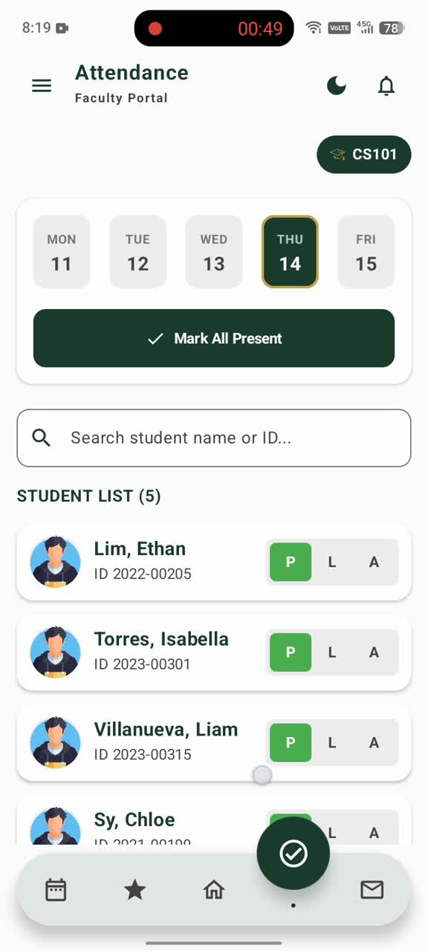
Attendance
Management

Slide 8
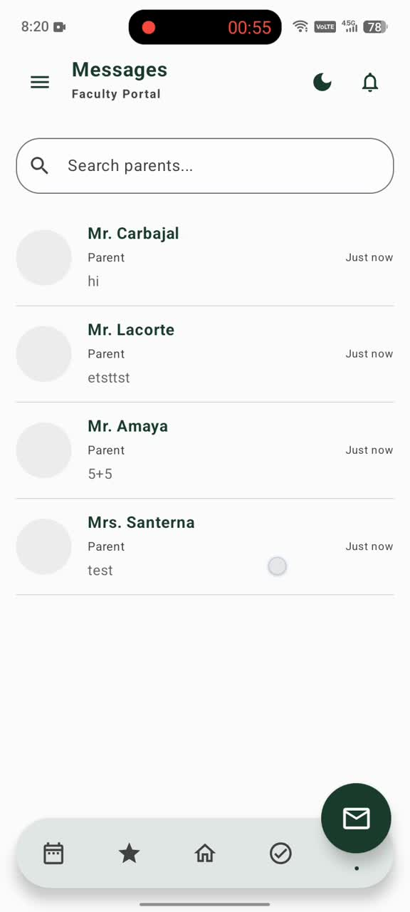
Collaborative
Messaging

Slide 9
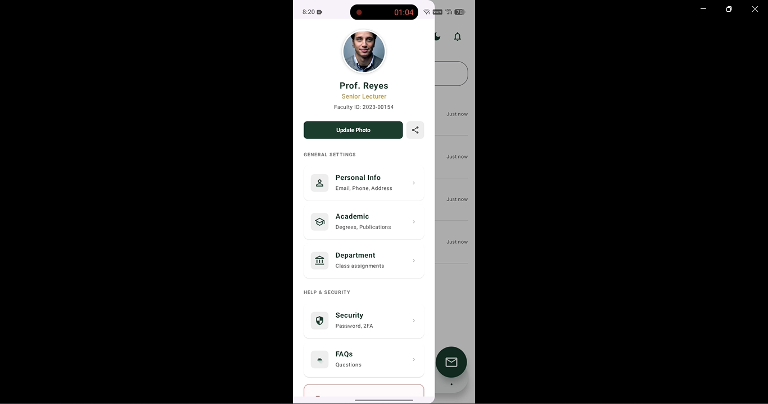
ON
THE
SIDE
MENU

Slide 10
YOU CAN
MANAGE
YOUR...

Slide 11
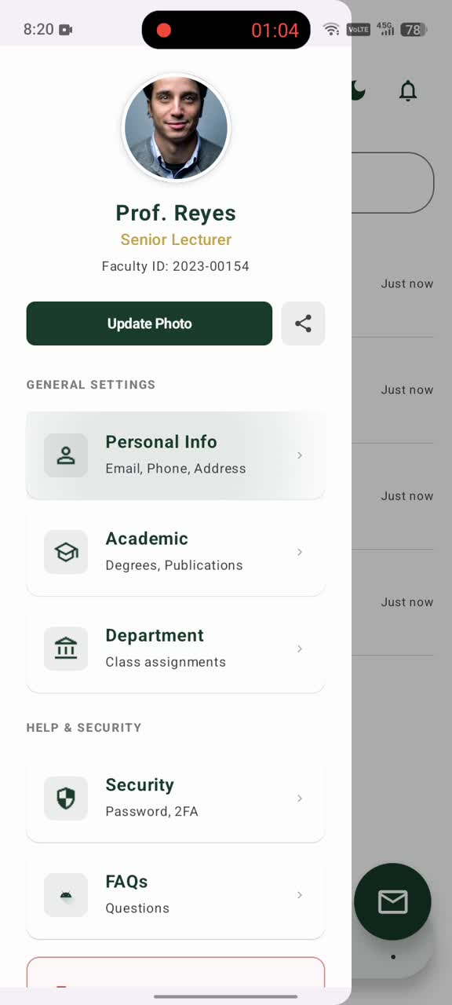
PERSONAL
INFO

Slide 12
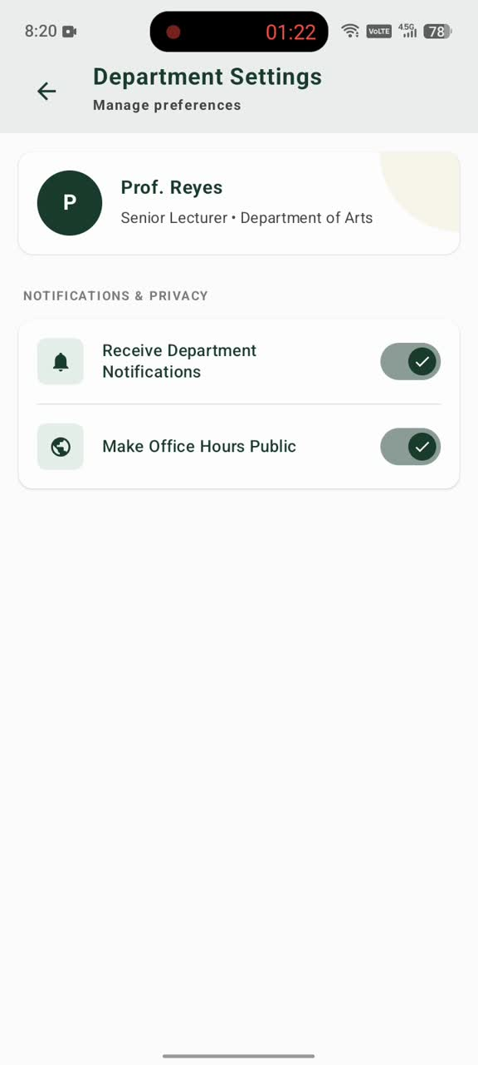
DEPARTMENT
SETTINGS

Slide 13
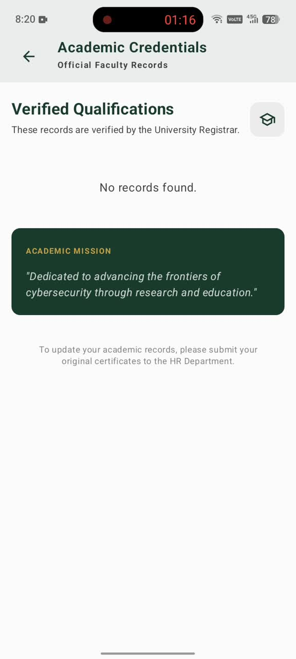
ACADEMIC
CREDENTIALS

Slide 14
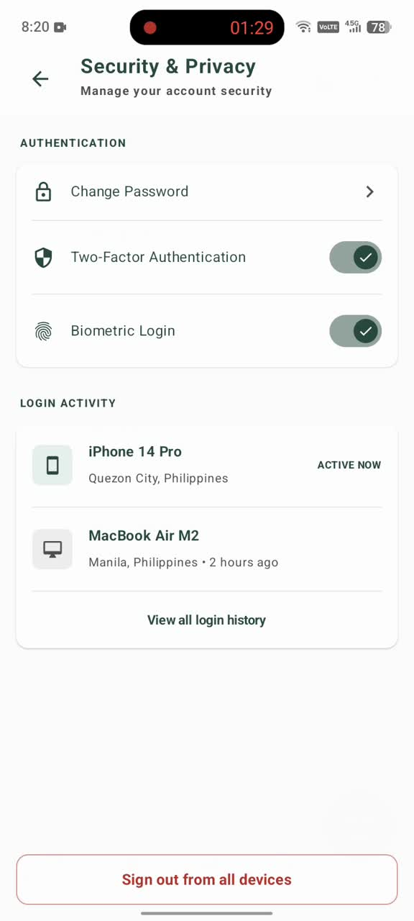
SECURITY
& PRIVACY

Slide 15
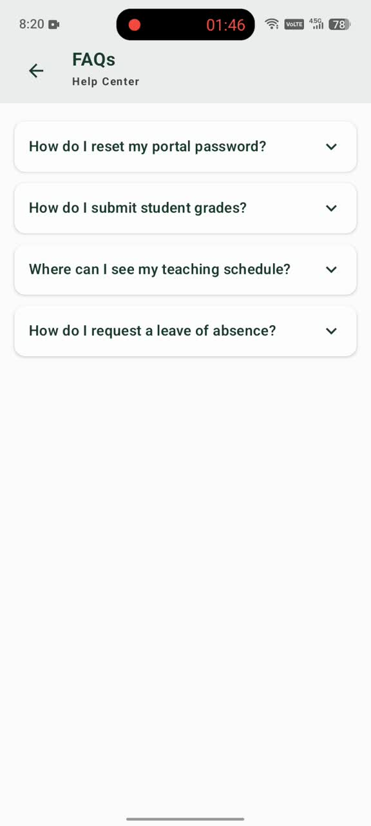
FAQS
How do I reset my portal password?
How do I submit student grades?
Where can I see my teaching schedule?
How do I request a leave of absence?

Slide 16
FINISHED?

Slide 17
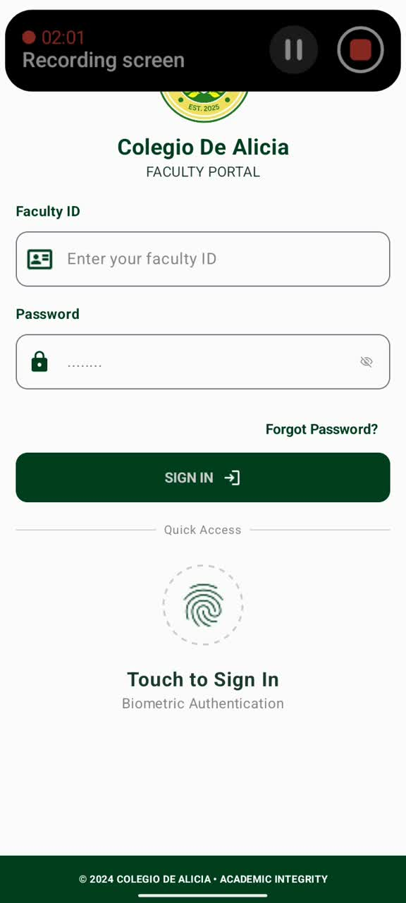
LOG OUT
ACCOUNT

Slide 18
Teacher App
COLLEGIO DE ALICIA

